Slide 1


COMPILER FOR IMAGE RECOGNITION PIPELINES
PRESENTED BY:
HARIKA. N
192371083
CSA1452
COMPILER DESIGN
Date: 03/04/2025

Slide 2
Introduction:
Overview of the Project
Develops a compiler to optimize and transform image recognition pipelines for efficient execution.
Utilizes graph optimization, operator fusion, and hardware acceleration for performance enhancement.
Supports multiple backends (TensorRT, TVM, XLA, Glow) for seamless integration.
Ensures parallel execution and dynamic tuning to maximize efficiency.
Adapts to different hardware architectures (GPU, TPU, CPU) for scalability.
Problem Statement
Traditional image recognition pipelines lack optimization, leading to slow inference times.
High computational cost due to redundant operations and inefficient memory usage.
Difficulty in adapting models to different hardware accelerators without manual tuning.
Lack of a standardized compilation framework for optimizing deep learning models.
Inefficiencies in real-time image processing applications due to bottlenecks.
Purpose of the Project
Automate optimization and deployment of image recognition models across hardware.
Reduce latency and improve throughput for real-time applications.
Enable seamless integration with existing ML frameworks (PyTorch, TensorFlow, ONNX).
Enhance scalability and flexibility for various image processing domains.
Provide a unified and efficient pipeline for developing and deploying AI-based image recognition systems.

Slide 3
Objectives:
Define Clear Goals
Develop a compiler that optimizes image recognition pipelines for efficient execution.
Automate model optimization for different hardware architectures (CPU, GPU, TPU).
Enable parallel processing to accelerate image recognition tasks.
Provide interoperability with existing machine learning frameworks (TensorFlow, PyTorch, ONNX).
Ensure memory efficiency and reduced computational overhead in deep learning models.
Address the Problem Statement
Optimize image recognition workflows to reduce execution time and resource usage.
Enhance scalability for large-scale image datasets and deep learning models.
Reduce dependency on manual tuning by automating hardware-specific optimizations.
Expected Outcomes
Faster and more efficient execution of image recognition tasks.
Reduced inference latency through hardware-aware optimizations.
Scalable and adaptable compiler for different AI applications.
Optimized memory and power consumption for real-time processing.
Seamless integration with various deep learning and computer vision frameworks.

Slide 4
Literature Review / Background:
Summary of Existing Research
Optimizing deep learning models for image recognition has been explored in various frameworks like TensorFlow, PyTorch, and ONNX.
AI compilers such as TVM, XLA, and Glow have been developed to enhance performance across different hardware platforms.
Graph-based optimizations (e.g., operator fusion, pruning, quantization) significantly improve inference speed.
Challenges exist in ensuring cross-platform compatibility and efficient execution on edge devices.
Theoretical Foundation
Based on compiler design principles for optimizing image processing workflows.
Utilizes graph transformations and intermediate representation (IR) for efficient execution.
Leverages parallel computing techniques for hardware acceleration (GPU, TPU, FPGA).
Applies memory optimization strategies to reduce computational overhead.
Research Gap
Limited research on AI compilers specifically optimized for image recognition pipelines.
Existing solutions focus on general deep learning model optimization rather than domain-specific needs.
Lack of adaptive compilation that dynamically tunes models for different deployment environments (cloud, edge, mobile).
Need for an integrated framework that seamlessly connects with ML pipelines and hardware accelerators.

Slide 5
Methodology:
Tools & Frameworks Used
Python for backend development and compiler implementation.
LLVM/MLIR for intermediate representation and code optimization.
TVM/XLA for optimizing deep learning models on different hardware.
CUDA/OpenCL for accelerating computations on GPUs.
ONNX for ensuring model interoperability across frameworks.
Development Approach
Agile methodology with iterative improvements in compiler performance.
Prototyping-based approach to test different optimization techniques.
Continuous benchmarking to evaluate execution speed and efficiency.
User feedback integration to refine optimization strategies for real-world applications.
Data Collection (If Applicable)
Existing deep learning models from TensorFlow, PyTorch, and ONNX repositories.
Image processing benchmarks to evaluate compiler performance.
Hardware profiling data for optimizing execution across different architectures.
Feedback from developers using the compiler in real-world image recognition tasks.

Slide 6
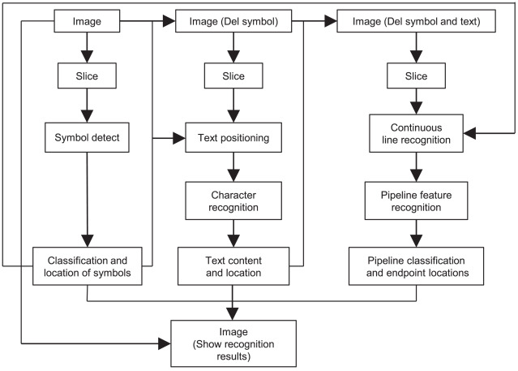
System Design / Architecture:
Flowcharts & block diagrams

Slide 7
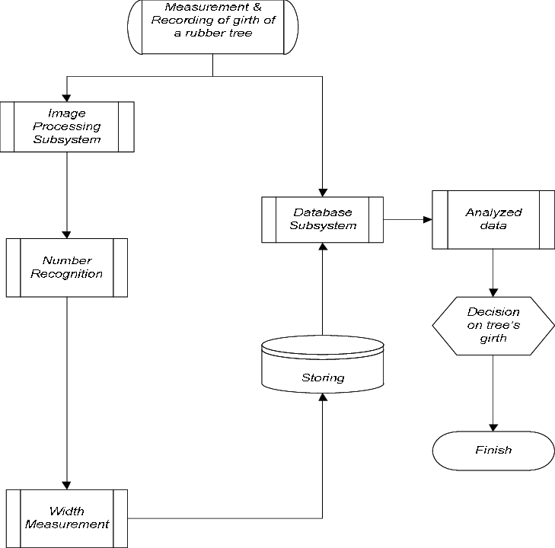
Technology Stack Used
Frontend: HTML, CSS, JavaScript (for UI and model interaction).
Backend: Python (Flask/Django for API development and model management).
AI/Optimization: TensorRT, Apache TVM, XLA, Glow for model compilation and acceleration.
Hardware Acceleration: CUDA, OpenCL, ONNX Runtime for GPU/TPU optimization.
Database: PostgreSQL/MySQL for storing pipeline configurations and performance metrics.
Deployment: Docker & cloud platforms (AWS, Azure, GCP) for scalable inference.
System architecture

Slide 8
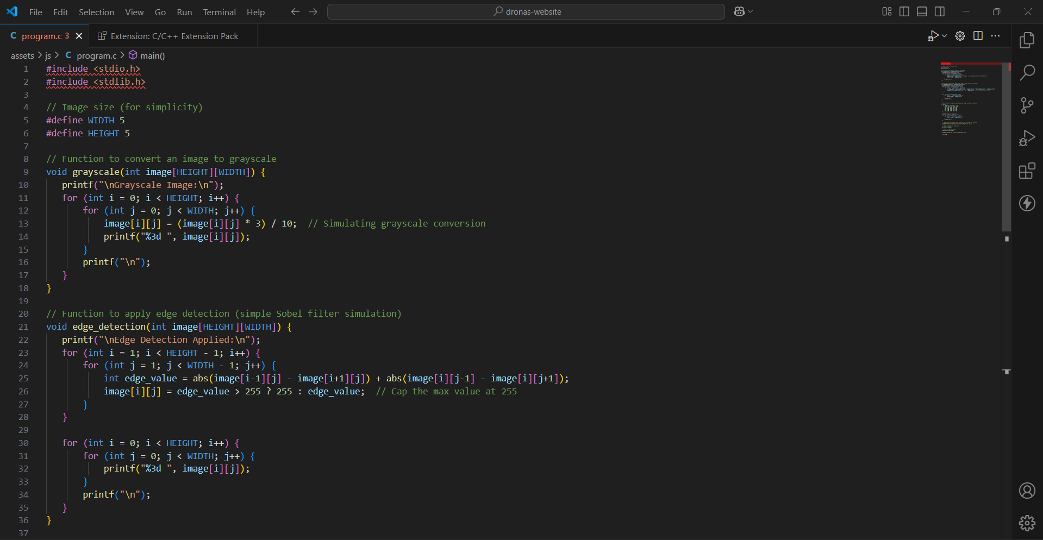
Implementation

Slide 9
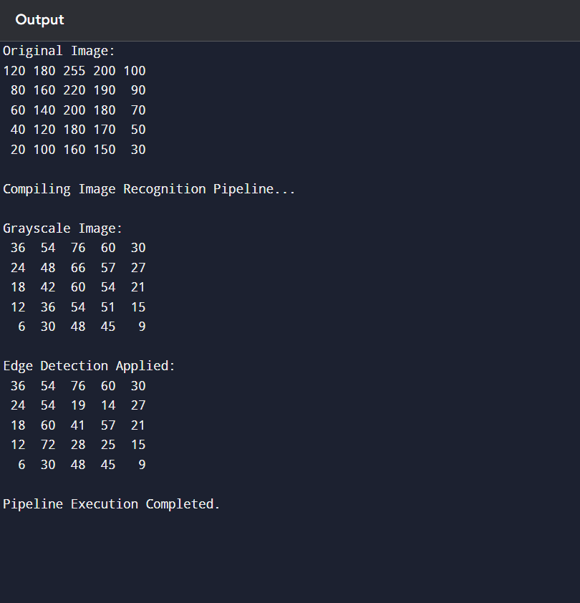
Output

Slide 10
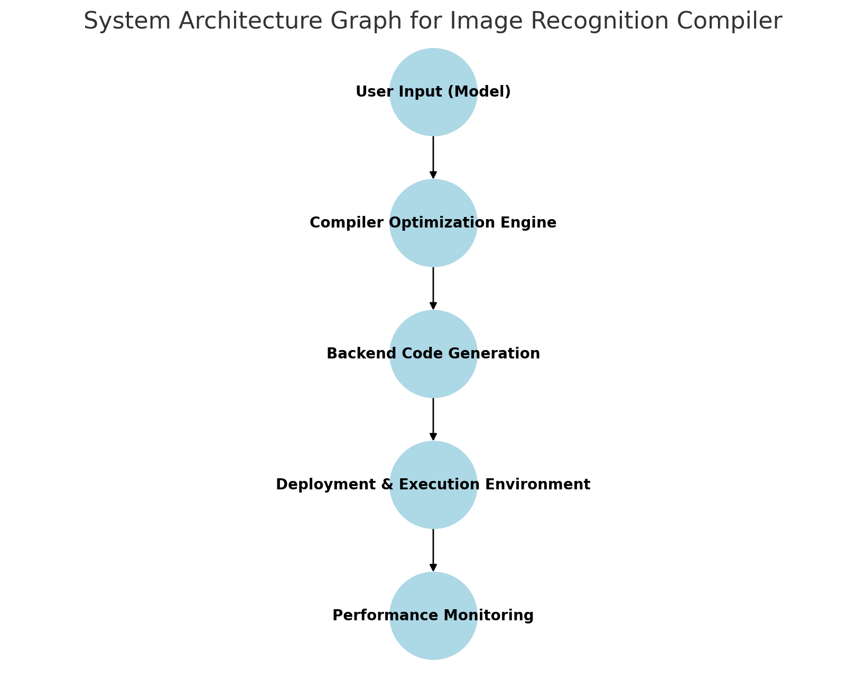
Data visualization

Slide 11
Challenges & Limitations
Issues Faced During Development:
Optimizing complex image recognition pipelines without compromising model accuracy.
Ensuring compatibility across multiple hardware accelerators (GPU, TPU, CPU).
Managing memory and computational efficiency during model compilation.
Handling variations in model architectures from different frameworks (TensorFlow, PyTorch, ONNX).
Debugging performance bottlenecks in real-time execution environments.
Possible Constraints:
Dependency on well-optimized deep learning models for efficient compilation.
Scalability challenges when compiling models for different hardware architectures.
Security concerns related to optimizing proprietary or sensitive AI models.
Limitations in AI compiler efficiency for extremely large-scale image datasets.

Slide 12
Future Scope
Enhancements or Improvements:
Implement advanced NLP techniques like transformer-based models for better requirement understanding.
Improve chatbot context retention for handling multi-turn conversations.
Enhance integration with project management tools for seamless requirement tracking.
Develop a user-friendly dashboard for real-time monitoring and analysis of gathered requirements.
How This Project Can Be Extended Further:
Expand support for multiple languages to cater to global teams.
Incorporate voice-based interactions for a more intuitive user experience.
Leverage AI-driven analytics to provide insights and recommendations on gathered requirements.
Deploy the system on cloud platforms for better scalability and accessibility.

Slide 13
Conclusion
Summary of the Project:
The compiler for image recognition pipelines optimizes and transforms deep learning models for efficient execution across different hardware.
It utilizes graph optimizations, operator fusion, and hardware acceleration to enhance performance.
The system integrates with multiple AI frameworks (TensorFlow, PyTorch, ONNX) for seamless model compilation.
By reducing computational overhead, it improves real-time image processing efficiency in various domains.
Key Takeaways:
Optimized compilers can significantly enhance image recognition model performance.
Graph optimization and hardware-aware compilation improve efficiency and execution speed.
Integration with AI frameworks ensures broad usability and adoption.
Future advancements in compiler techniques can further improve scalability and real-time processing.

Slide 14
References
Gonzalez, R. C., & Woods, R. E. (2018). Digital Image Processing (4th ed.). Pearson.
Goodfellow, I., Bengio, Y., & Courville, A. (2016). Deep Learning. MIT Press.
Szeliski, R. (2022). Computer Vision: Algorithms and Applications (2nd ed.). Springer.
O’Gorman, L., Samet, H., & Stockman, G. (2008). Computer Vision and Image Processing: A Practical Approach Using CVIPtools. Prentice Hall.
Russ, J. C. (2016). The Image Processing Handbook (7th ed.). CRC Press.

Slide 15
Thank You!
Feel free to ask if you have any questions or need further clarifications on:
Project functionality – How the compiler optimizes and transforms image recognition pipelines.
Technical details – Tools, frameworks, and hardware acceleration techniques used.
Challenges & Solutions – How we addressed performance bottlenecks and compatibility issues.
Future Enhancements – Potential improvements for better efficiency, scalability, and adaptability.

